Slide 1
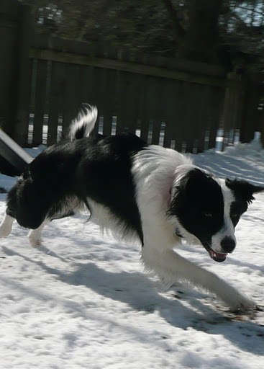
K9 Fitness badge o&S
Dog Scouts of America

Slide 2
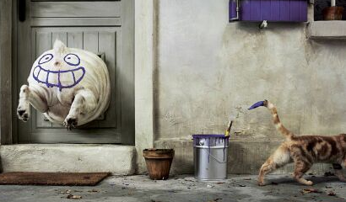
Why is it important that my dog be fit?
Excess weight causes stress on heart, lung, liver, kidneys, and joints
Increased risk of injury and/or overheating
Worsens osteoarthritis
Increased risk of diabetes
Increased risk during surgery
Reduced quality of life
Shortened life expectancy
Plus, fit dogs
have more FUN!!!

Slide 3
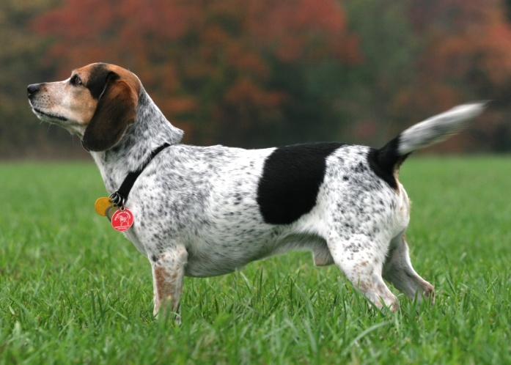
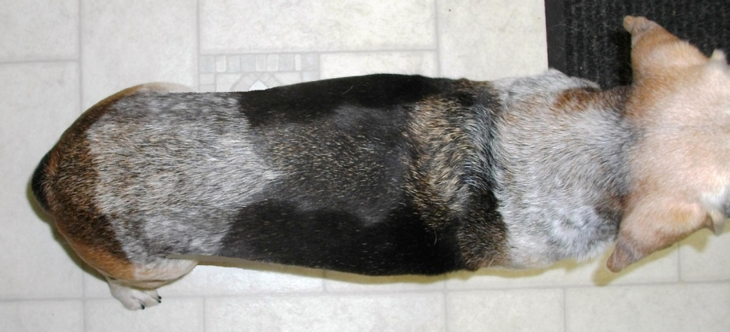
Is my dog fit?
All ribs should be easily palpable, but not visible.
Some breeds, such as sight hounds, may have visible ribs even at healthy weight.
Abdominal tuck visible when viewed from side.
Waistline evident when viewed from top.
Estimated 25-40% of pet dogs are overweight.

Slide 5
Getting Ready to Get Fit
Evaluate current fitness level of both dog and yourself
How much exercise is dog getting currently?
What kind of shape is my dog already in?
Start gradually and build up to desired fitness level
May want to consult veterinarian before starting exercise program, especially if your dog has known health or structural issues

Slide 6
Individual Considerations
Puppies and older dogs:
Minimize high impact/long duration activities for young puppies while growth plates are closing
Keep an eye on your older dog for signs of soreness, tiring faster, etc.
Brachycephalic (short snout) breeds:
More prone to heat exhaustion. Watch carefully in warmer temps.
Dogs with health conditions or structural problems

Slide 7
What type of exercise?
Aerobic activity – get dog’s heart rate up for at least 15 minutes at a time
Lots of possibilities:
Walking/hiking
Running
Cycling
Skijoring
Swimming
Fetch/Frisbee
Treadmill
Restrained recalls
Anything aerobic you and the dog do together!

Slide 8
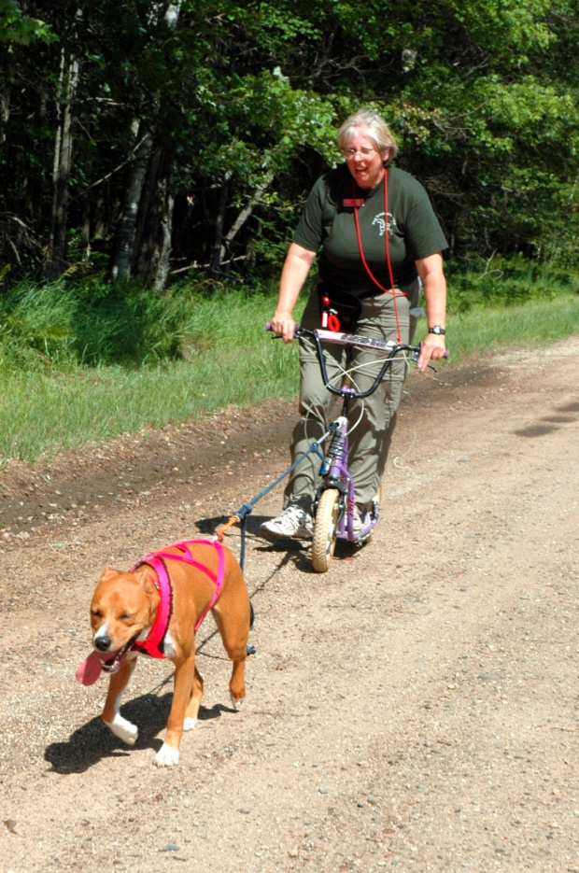
What if I can’t keep up with my dog?
Find ways to participate and interact with the dog as much as possible with your own fitness and mobility.
Playing fetch, training dog to walk on treadmill, letting dog swim, playing recall games between multiple members of the family – all can get dog moving even if you aren’t able.
But, turning the dog out into the backyard to entertain himself does not count!

Slide 9
How much is too much?
Raymond Coppinger: “dogs are the world’s best endurance athletes”
Still, they can’t go from couch potato or weekend warrior to Iditarod racer overnight
Start at current fitness level, and build gradually over several weeks
Build in rest days
Monitor dog for signs of soreness, lameness, lethargy
This should be fun – don’t force dog (or yourself) to do too much too soon
Set goals

Slide 10
High Impact Activities
Get dog fit BEFORE engaging in high impact activities, such as agility, flyball, disc dog, distance running, etc.
Sports should be used to maintain and build strength and fitness, but dog should be in shape first
Go easy with puppies – don’t go too long or encourage too much jumping until growth plates close due to risk of joint damage

Slide 11
Workout Safety
Use appropriate equipment for given activity
Shouldn’t restrict movement or put too much force on single body part.
Head halters and front clip harnesses may not be appropriate for some activities.
If activity involves pulling (e.g., skijoring), leash should be attached to properly fitting, V-front harness.
Do not use devices that use aversive stimuli, such as choke collars and prong collars.
Make sure area is safe for the dog, and you are following any applicable rules/laws.

Slide 12
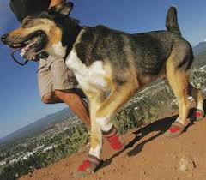
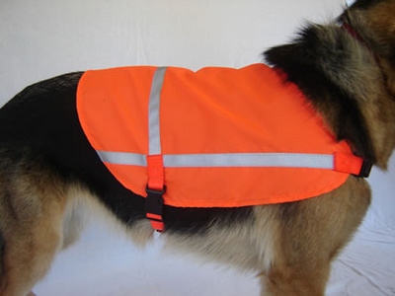
Safety Gear
May consider reflective vests and headlamp for yourself, reflective leash/harness/vest for dog.
Paw protection for rough terrain
Dog boots
Pad conditioners
Identification: for dog and yourself
www.roadid.com
Cooling coats
Chillybuddy or Cool Coats

Slide 13
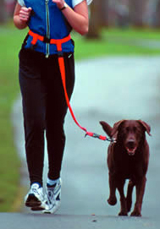
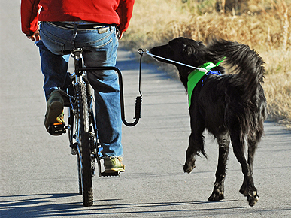
Other Fun Optional Gear
Padded, non-restrictive harnesses
Waist leashes
Bike attachment (Walky Dog, Springer, etc.)

Slide 14
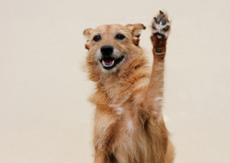
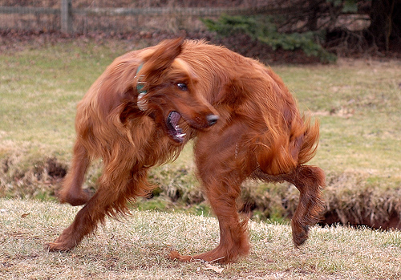
Before and After
Warming up
Five to ten minutes walking/trotting
Stretch limbs, toes, spine – preferably with active stretching at this point
Cooling down
Slow down to trot or walk for five to ten minutes.
Repeat stretches – active and passive

Slide 15
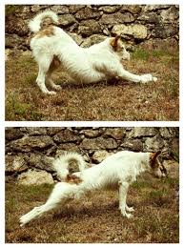
Stretching
Active Stretching
Weave between handler’s legs, bow, put feet up to “dance”/stretch, curl body to left and right.
Can put dog’s natural stretching behavior on cue.
Passive Stretching
Flexion, Extension, Abduction, and Adduction
Focus on toes, limbs, neck and spine
Do not force! If dog resists, stop and assess for signs of soreness there.
Stretch should be steady and continuous, not bouncy or jerky
Stop if muscle tension increases
Ideally, hold for 15 to 30 seconds

Slide 16
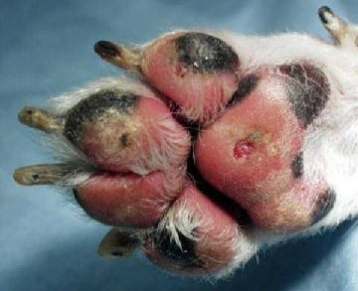
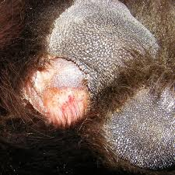
Safety on the Go
Follow rules of the road/trail
Keep an eye on your dog – stop if she is lagging behind, gait seems abnormal, trying to stop, etc.
Watch for overheating!
Dogs’ bodies are not as good as ours at cooling, especially if overweight.
Keep hydrated (both of you!)
Inspect pads regularly.
Weather conditions.

Slide 17
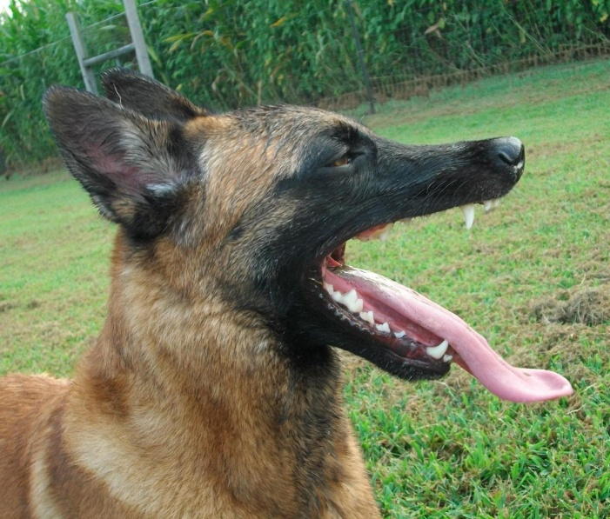
Overheating: Signs
Heavy panting
Brick red gums (seen in mild or moderate heat stroke cases)
Pale gums (seen in severe hyperthermia cases)
Dry gums
Sticky, thick saliva
Confusion and disorientation
Stumbling and poor coordination
Collapse or inability/refusal to walk
Vomiting (sometimes, with blood)
Diarrhea
Seizure or tremors
Loss of consciousness and coma

Slide 18
Overheating: What to Do
If possible, take temperature
104-106 degrees indicates heat stroke
Over 105 degrees = medical emergency
Call vet for guidance
Move out of the sun and heat; ideally, to an indoor, air conditioned location
Fill a tub with a few inches of cool water
Pour room temperature water over the dog's entire body
Aim a fan at the wet dog (if a fan is unavailable, fan the dog manually with a magazine or similar item)
Offer a bowl of cold water for drinking (not too much at once)
More info: http://www.dogscouts.org/uploads/Beating_the_heat-_heat_stroke_prevention.pdf

Slide 19
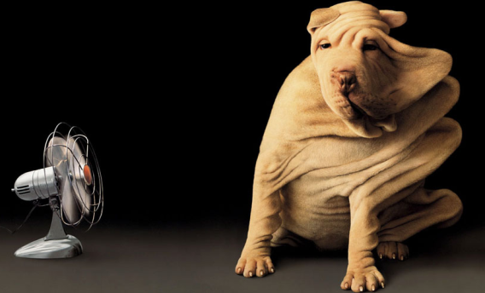
Overheating: What NOT to Do
Do not use ice cold water – can shock system.
Do not put in deep water – heavy panting or collapse could present drowning risk.
Do not drench coat. Focus on wetting belly and limbs.
Do not force to drink – may aspirate or choke if panting too hard.
Fans don’t have effect on a dry dog.

Slide 20
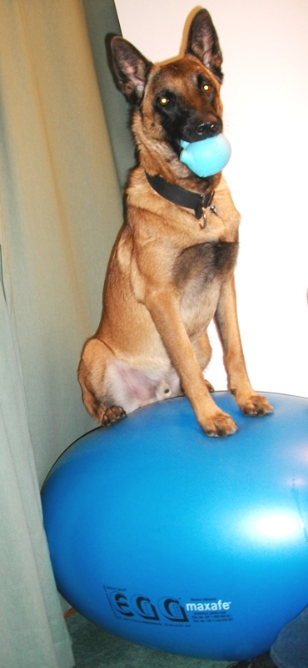
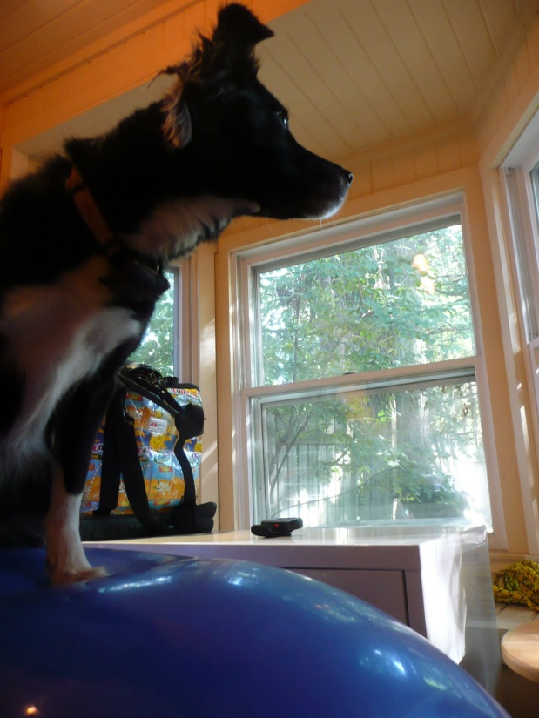
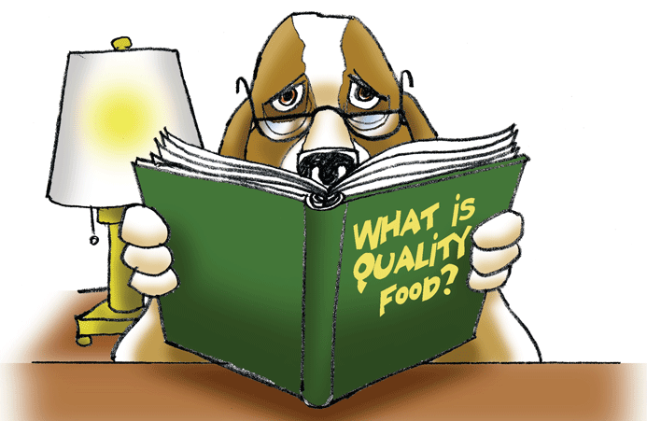
Maintaining your Fit Dog
Strength building
Body awareness (proprioception)
Massage
Proper Nutrition

Slide 21
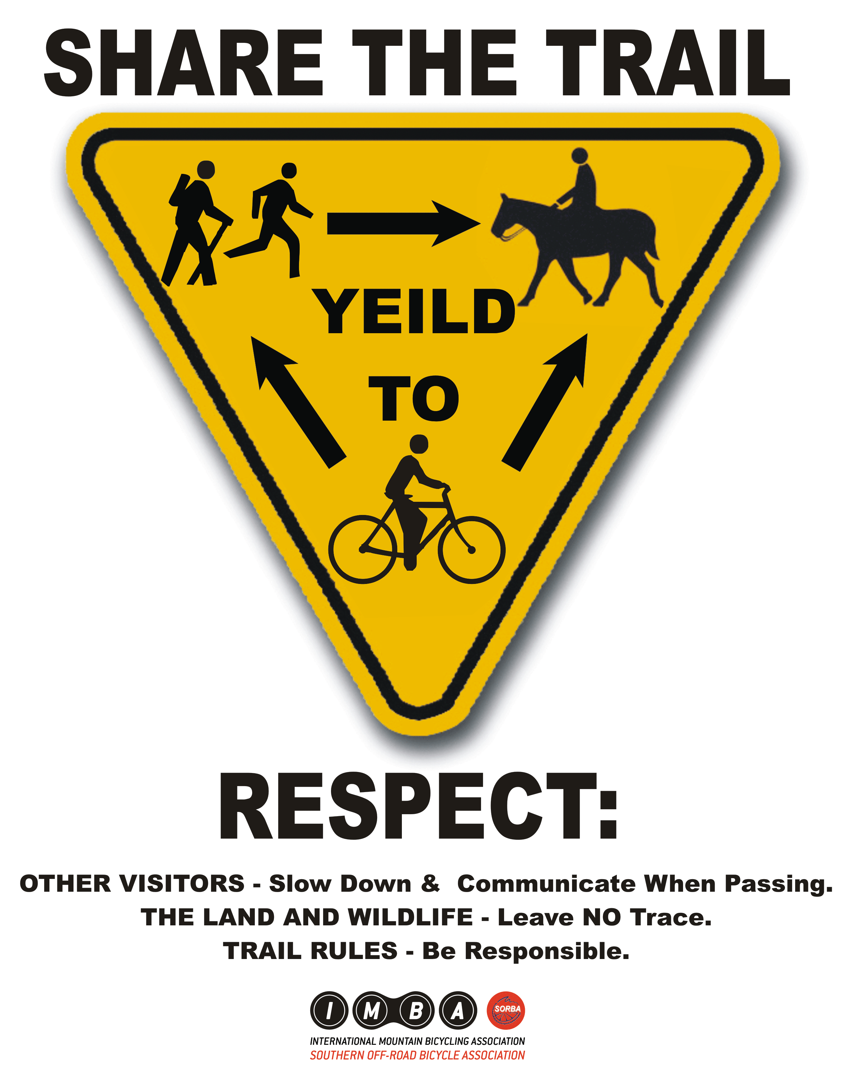
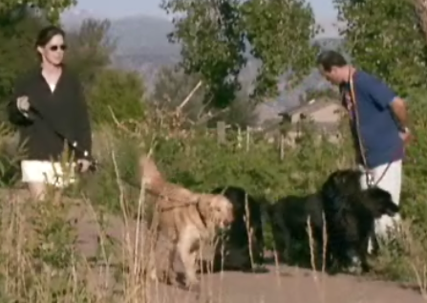
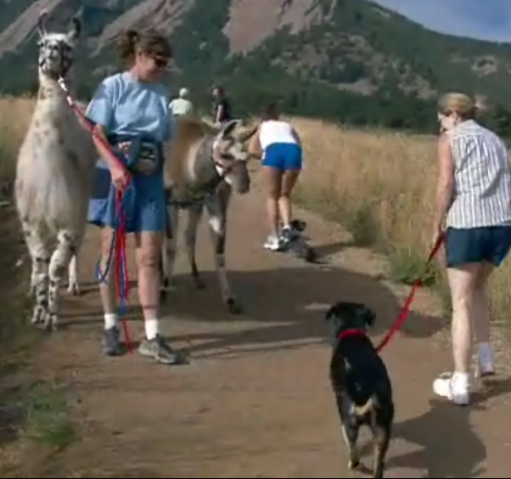
Remember: Be A Good Dog Scout
Clean up after your dog
Follow area use rules
If sharing a trail with other users, dog should not cause a disruption or pose a danger
Maintain leash manners

Slide 22
Resources:
Structure, Conditioning, Strength and Stretching
Chris Zink:
Peak Performance: Coaching the Canine Athlete
The Agility Advantage
DVD: Building the Canine Athlete
Debbie Gross-Saunders:
Getting on the Ball (1 and 2) DVDs
Strengthening the Performance Dog DVD
Stretching the Performance Dog DVD
Numerous articles in Clean Run magazine (www.cleanrun.com)

Slide 23
Resources
Massage:
Book: Canine Massage in Plain English by Natalie Winter
DVD: How to Massage Your Dog (Maria Duthie)
Nutrition:
Performance Dog Nutrition by Jocelynn Jacobs
K9 Kitchen: The Truth Behind the Hype by Monica Segal
The Whole Dog Journal (www.whole-dog-journal.com)

